Slide 1
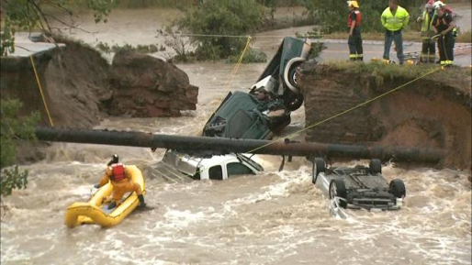
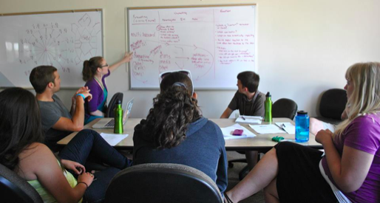
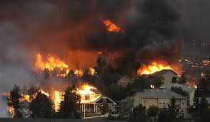



How Social Sciences Are & Are Not Being Woven Into Meteorological Science
Eve Gruntfest, Ph.D.
Social Science Woven into Meteorology
Professor Emeritus Geography
University of Colorado Colorado Springs, CO USA www.evegruntfest.com
WWOSC August 18, 2014
Montreal, Canada

Slide 2
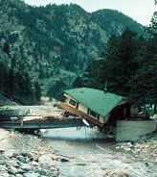
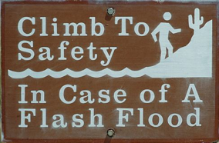
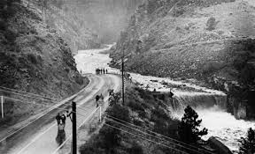
Career as socio/hydro/meteoro/logist
1976 Big Thompson Flood
Studied the
behaviors
that night
Who lived?
Who died?
Add-on social scientist in world of engineers/physical scientists
Notes:
My career has mostly been serving as an add on social scientist – last ten years.. Working toward better integration of social sciences and physical sciences – particularly meteorology and hydrology
Last week I went up the Big Thompson Canyon and observed the new destruction from the 2013 flood. Having completed my masters thesis in 1977 on the actions people took during the 1976 flood that led to them either living or being one of the l44 people who died in that flood – it was remarkable and surreal to see the impacts of the most recent floods – and appreciate that in 2013 even though the flooding was severe – the death toll was orders of magnitude smaller – as a result of decades of work by NOAA and many others – to assure that (unlike in 1977) very few people were ON the roads when they washed out!
… encourage you to go on a field trip if you have any time – even just outside boulder along lefthand creek the flood effects are still easy to see … and you can appreciate the magnitude of the event from nearly one year ago

Slide 3
Today’s goal: Spark interest in learning more - for those new to the intersection of social science & meteorology & - for those with familiarity with the work
Research examples
Cases & faces
Networks & people doing
the work
* means they are
presenting at WWOSC
HEATWAVES Stakeholder, physical & social science collaborations
ETHNOGRAPHY (method) shows time frames that emergency managers & broadcast meteorologists use
HOW WARNINGS ARE USED Evaluating forecaster assumptions
Challenges

Slide 4

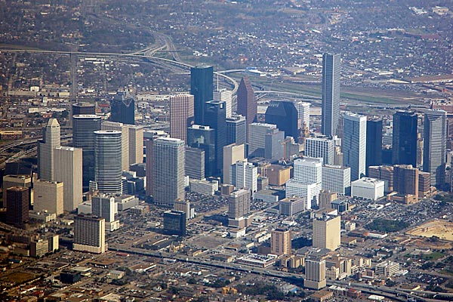










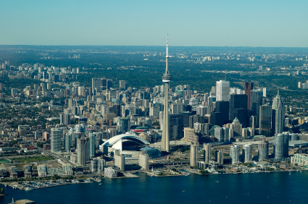
Urban heat wave mitigation System for integrated modeling of metropolitan extreme heat risk (SIMMER)
RAL
CGD
IMAGe
Goal: Advance methodology for assessing current & future urban vulnerability from heat waves through integration of physical & social science models, research results & remote sensing data

Slide 5
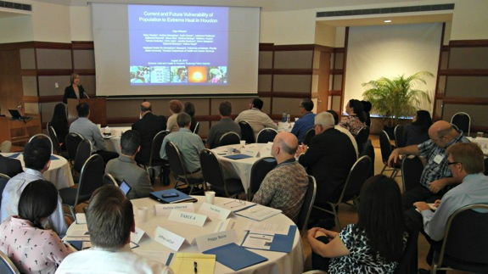
SIMMER project team
local national & international
National Center for Atmospheric Research
University of Kansas
Houston Department of Health & Human Services
Canadian collaborators
Toronto Public Health, Ryerson University, Health Canada, Toronto Environment Office & Ontario Ministry of Environment
http://www.ral.ucar.edu/projects/simmer

Slide 6
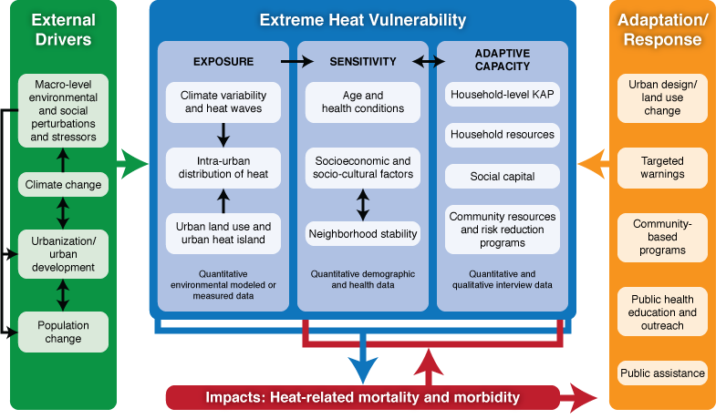
Conceptual/analytical framework
Wilhelmi & Hayden (2010, ERL)
Notes:
The framework, presented here disassembles vulnerability of the system into three interactive components: exposure (i.e., climate and synoptic weather conditions which are
exacerbated by the reflective, storage, and transportation characteristics of urban materials and vegetation), ,sensitivity (i.e., the extent to which a system or population can absorb
impacts without suffering long-term harm), and adaptive capacity (the potential of a system or population to modify its features and behavior so as to better cope with existing and anticipated stresses).
Each component consists of a set of dynamic, spatially variable indicators, which in turn are affected by external drivers, such as climate change, macro-scale socio-economic and environmental stressors and urbanization trajectories. For example, the pathway of urban development (e.g., large-scale urban agglomerations) can influence urban land use and consequently, the urban heat island, which disproportionately affects human exposure to excessive heat during the day and night time. Macro-scale socio-economic stressors, such as economic downturn, affect sensitivity of the socio-ecological system, through its impacts on housing, employment (i.e., decreased neighborhood stability, increased socio-economic disadvantage, limited household resources for cooling) and health conditions of individuals (i.e., limited access to healthcare).
Various combinations of the exposure, sensitivity and adaptive capacity indicators result in spatially differential negative impacts on human health.
The framework suggests specific heat stress adaptation and response strategies to target specific corresponding indicators of vulnerability (i.e., causes of impacts), rather than targeting a composite measure of vulnerability in a given location.

Slide 7
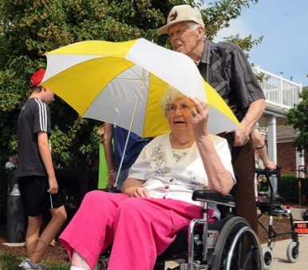
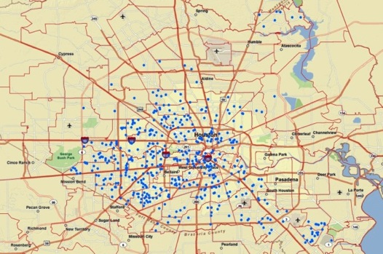
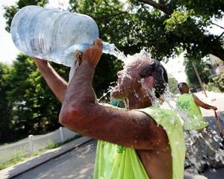
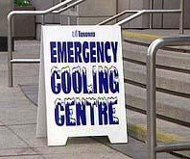
Population’s adaptive capacity
901 households in Houston, Texas (2011)
98% of survey respondents had central or window air conditioning
37% of all respondents felt too hot inside their homes
14% of respondents reported that the cost of electricity prevented them from using their air conditioners
25% of respondents indicated having trouble paying their electric bill
Hayden et al. (in preparation)

Slide 8
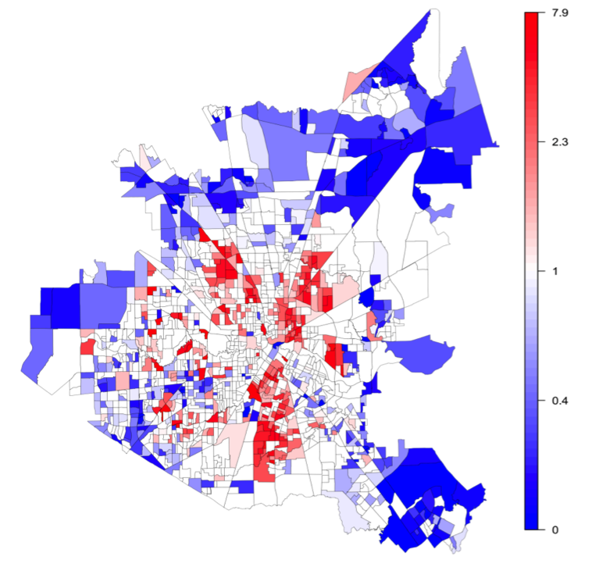
Heat-health risk factors
Projected increase in heat stress nights is a concern for public health, as daily minimum temperatures show significant associations with heat-related mortality
Extreme heat disproportionately affects elderly, low income & socially isolated people
Heaton et al. (Spatial & Spatio-Temporal Epidemiology)

Slide 9
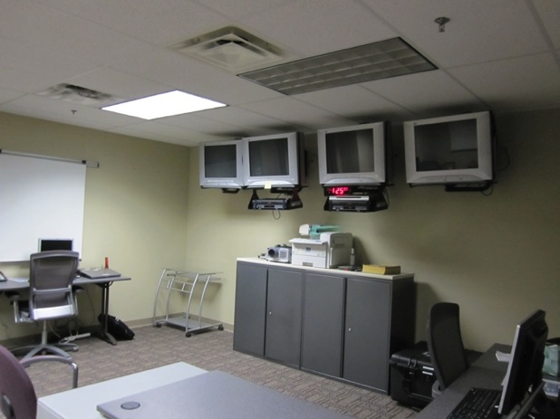
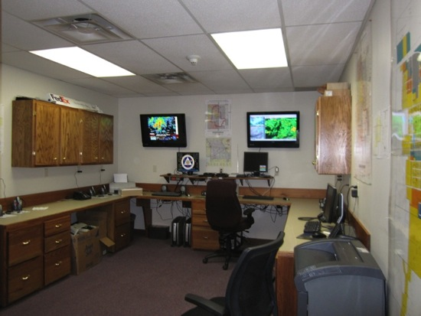
Ethnography research objectives – Jen Spinney
Reframing the development of weather information tools based on emergency managers needs (2011 - Texas, Missouri & Kansas)
By understanding what emergency managers need to enhance the development of new National Weather Service forecasting tools
Notes:
Our research objectives are quite specific. Essentially our role and objective in the IHIS project is to help reframe the development of weather information tools so that they are based on the expressed needs of EMs.
And we attempt to reach our objective by…understanding EMs’ needs, the decisions they make, their communication practices during hazardous weather, to name a few, and then share this information with software developers so that all of this rich, detailed information can then be included in IHIS.

Slide 10
Ethnography: Watch and listen to learn how emergency managers think
Have multiple roles & responsibilities, varying backgrounds & years of experience
Are of various ages, with differing political beliefs, values & rules
Have differing resource capabilities
Have different information needs
Perceive risk differently
Think of time & space in different ways
Use a variety of methods to communicate
Emergency managers are diverse
A one size fits all approach is ineffective
What people say they will do might be different than what they actually do
Notes:
As we built our sample, it was continuously confirmed and reconfirmed why it’s necessary to conduct this type of research with EMs. And that’s because…
County, City, State
Full time, part time, and volunteer
In essence this ethnographic research is so very important because ems and em practices are diverse and as a result a one-size fits all approach to the development IHIS, and weather tools in general, is ineffective.

Slide 11
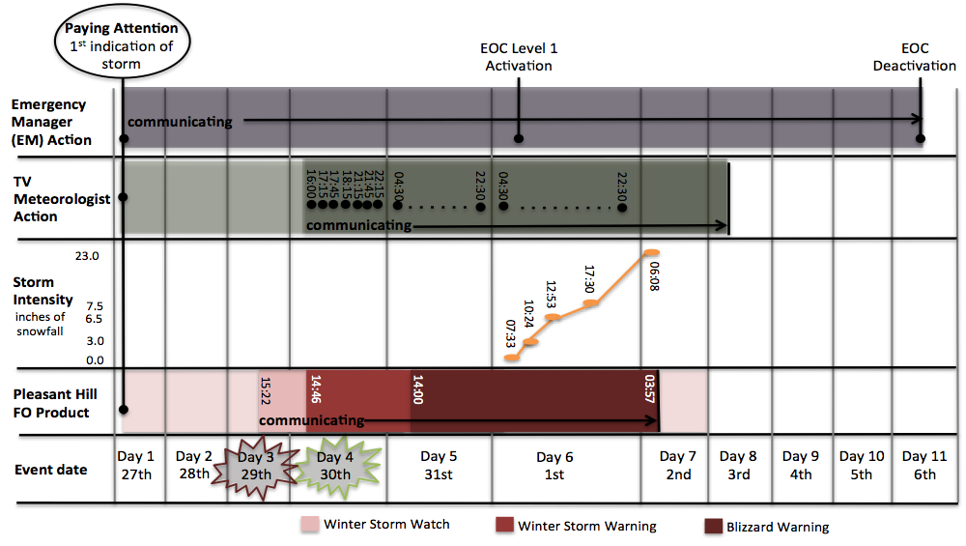
Spinney & Gruntfest 2012- Missouri snowstorm 2011
Notes:
Stakeholders also have particular time concerns.
This is a timeline for acquiring and communicating information leading up to and after a one-day snowfall in western Missouri. On the left are the different actors involved and at the bottom is the chronology of days as the event unfolded.
It provides a good example of the ranges and sequences of time that forecasters, a TV meteorologist, and an EM paid attention to and communicated the threat of hazardous weather during a snowfall event in Missouri last winter. The timeline shows the particular ways that each stakeholder thought about the event: It was a 7 day event for forecasters, an 8 day event for TV meteorologist, and an 11 day event for the Emergency Manager. It wasn’t only about what happened during a 12-hour snowfall.

Slide 12
Spinney & Gruntfest – study of Missouri snowstorm 2011
Notes:
Stakeholders also have particular time concerns.
This is a timeline for acquiring and communicating information leading up to and after a one-day snowfall in western Missouri. On the left are the different actors involved and at the bottom is the chronology of days as the event unfolded.
It provides a good example of the ranges and sequences of time that forecasters, a TV meteorologist, and an EM paid attention to and communicated the threat of hazardous weather during a snowfall event in Missouri last winter. The timeline shows the particular ways that each stakeholder thought about the event: It was a 7 day event for forecasters, an 8 day event for TV meteorologist, and an 11 day event for the Emergency Manager. It wasn’t only about what happened during a 12-hour snowfall.

Slide 13
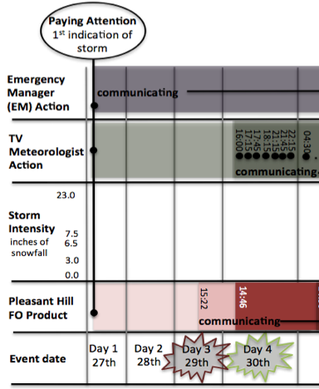
Notes:
The timeline shows that all three stakeholders acquired information at the first indication of hazardous weather but also that each exhibited significant diversity when it came to communicating weather information.
They individually chose when and how frequently information was shared. Forecasters and TV meteorologists in particular adhere to institutional rules for communicating threat and are responsible for informing the public with the most current and potentially hazardous weather information. They focused their time on communicating current threats. During this event, NWS issued the 1st official watch on Day 3, whereas the TV meteorologist began communicating on-air on Day 4. Decision is driven by institutional rules for communicating threat. This differs from EMs who commonly begin communicating with their partners at the first indication of an approaching hazardous weather system and continue to communicate long after the snow has stopped falling. Decision is driven by potential and/or experienced impacts.

Slide 14
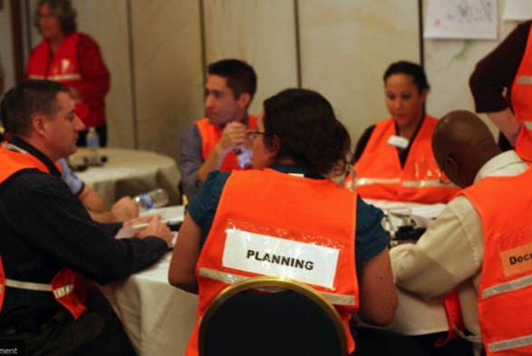
Stakeholders have varying time frames & risk thresholds
Emergencies are only a small part of emergency managers’ work during the year
Broadcast meteorologists – 2 days before snow
Particular attention to first snow of the season
Actual snowfall weather event is short time
US National Weather Service
Strict criteria for severe in winter, flooding, hail
Notes:
Training. Coordinating and planning… and the actual weather is short time

Slide 15
Research findings challenge assumptions
We think we know that
If emergency managers have the capability to narrow the warning to part of the county they would use it
Emergency managers always issue warnings when the National Weather Service issues a warning

Slide 16
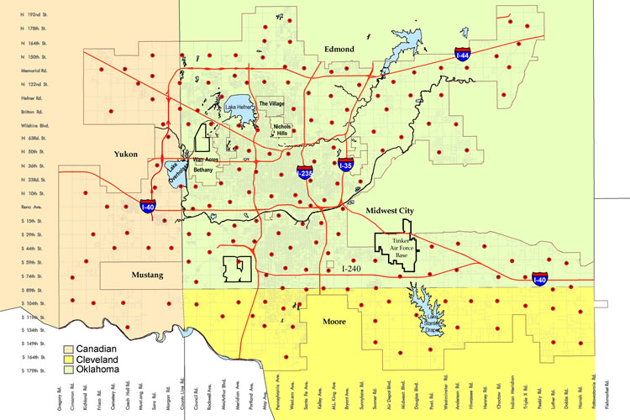
League et al. 2012
Storm-based Tornado Warning
Oklahoma City 620 Sq. Miles

Slide 17
League et al. 2012
Q: Does your EM operation have the capability to warn SUBREGIONS or areas within its jurisdiction?
 | OK (n=93) | TX (n=97)
YES | 44% | 66%
No | 56% | 34%
Subregional Warning Frequency | OK (n=37) | TX (n=64)
80% or more of the time | 48% | 19%
60-79% of the time | 10% | 8%
40-59% of the time | 3% | 9%
20-39% of the time | 0% | 5%
<20% of the time or Never | 33% | 48%
I don’t know | 8% | 11%

Slide 18
League et al. 2012
Q: Does your jurisdiction ALWAYS warn the public when the NWS issues a tornado warning that includes some portion of your jurisdiction?
 | Oklahoma (n=93) | Texas (n=95)
YES | 64% | 61%
NO | 36% | 39%
Q: Has, or would, your EM organization warn the public about a tornado threat when the NWS HAS NOT YET issued a warning for your area of jurisdiction?
 | Oklahoma (n=91) | Texas (n=92)
YES | 79% | 60%
NO | 21% | 40%
More evidence that warning criteria vary & we cannot assume we know how emergency managers behave

Slide 19

West Nile Virus study epidemiology - public awareness example
Folks >50 years old most vulnerable to severe manifestations
Public education campaign for elderly
NOBODY identifies themselves as“elderly”

Slide 20
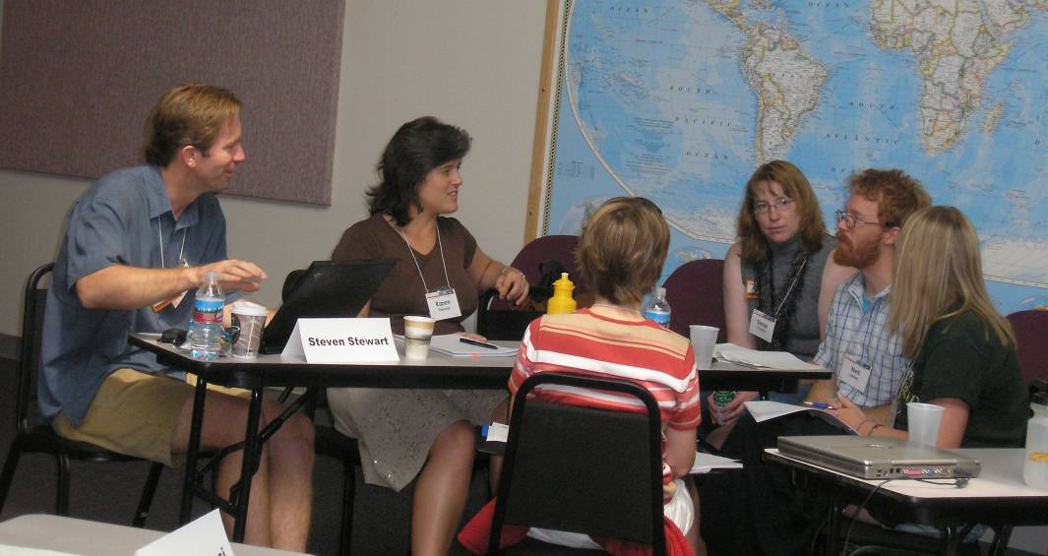
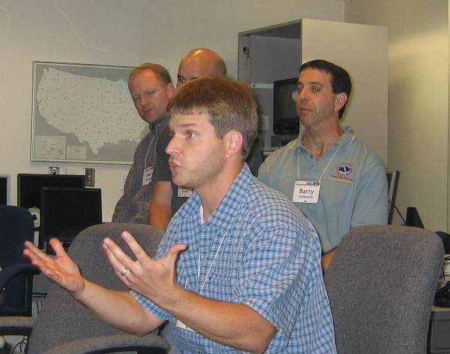
WAS*IS capacity building initiative addressed two persistent issues
I want to do work that integrates meteorology & societal impacts BUT….
- I don’t know how &….
- I don’t know anyone else who does
this kind of work

Slide 21
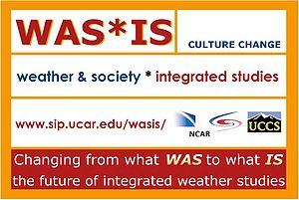
Weather & Society * Integrated Studies WAS*IS 2005-2011
300 WAS*ISers + hundreds more “friends” in US, Canada,
Australia, Caribbean, New Zealand, France, Germany
Australia

Slide 22
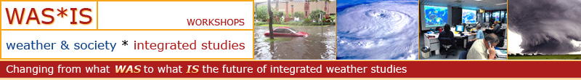
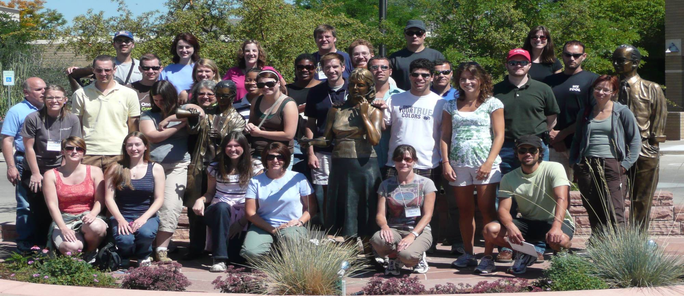
Changing the weather enterprise by comprehensively & sustainably integrating social science into meteorological research & practice
Notes:
Edited

Slide 23
WAS*IS mission – building socio-metero-logy capacity
Build an interdisciplinary community of practitioners, researchers & stakeholders — from the grassroots up — dedicated to the integration of meteorology & social science
Provide opportunities to learn and examine ideas, methods & examples related to integrated weather-society work
Tools – qualitative methods, surveys, interviews
Concepts – speaking the same language, problem definition
Topics – intros to social sciences, vulnerability & resilience

Slide 24
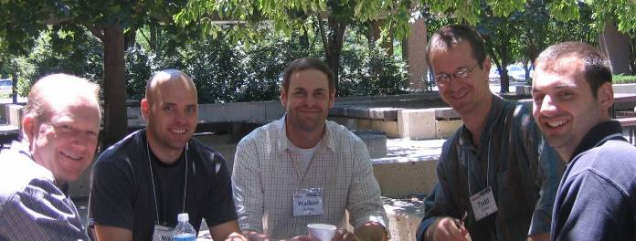
Public – private – nonprofit collaborations to improve all elements of weather enterprise – academic, private sector & US National Weather Service
with emphases on
Better communication
More geographic specificity
Partnership opportunities

Slide 25
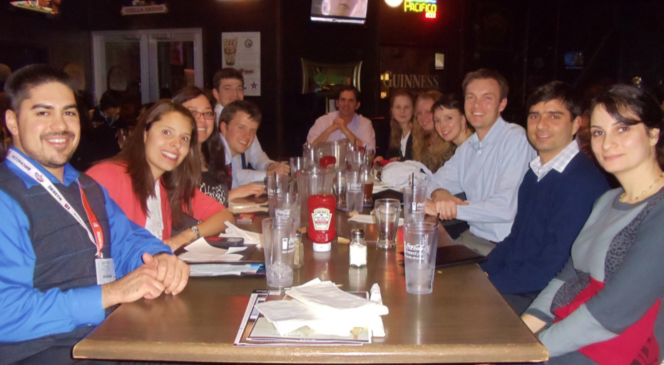
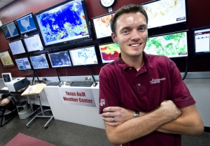
Russ Schumacher Atmospheric Science Professor Colorado State University
2013, 2014
SPREAD (Studies of Precipitation, flooding & Rainfall Extremes Across Disciplines) workshops
Bring together hydrology, meteorology, sociology, history Ph.D. students

Slide 26
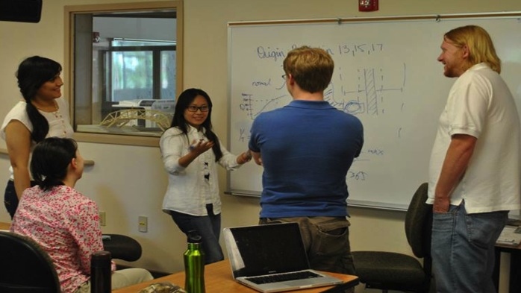
Statistician describing extreme value theory to hydrologist, economist, historian & meteorologist
SPREAD Comments
One of the strongpoints of the workshop was how it opened my eyes to how other fields look at flood events
Interdisciplinary research is inherently difficult, but the workshop reminded me that it's one of life's fun challenges. I feel reinvigorated & optimistic about doing good science
I have so much more insight into the social science perspective & their methods after this workshop

Slide 27


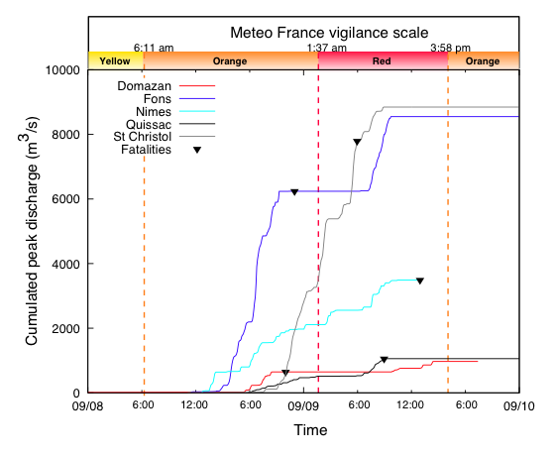
*Isabelle Ruin & colleagues in Grenoble, France
New time/space analysis
For floods: comparison of behavior of
basins, precipitation & people
Extreme speed of watershed responses
Extremely short lead-time for warnings

Slide 28
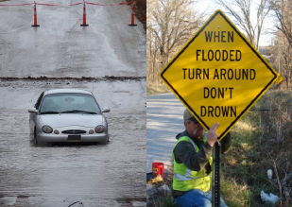

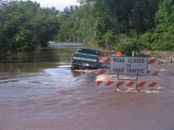
Research collaboration funded by NSF, NOAA & Dallas/Fort Worth Council of Governments
Develop mobile warnings based on personal vulnerability
Interdisciplinary post flood assessment: Physical & social scientists, engineers & policy makers
Social science research follow up / why did you do what you did?
Precision in time & space
Stan Lim
Notes:
One example of the trend toward tailoring warnings to vulnerable populations – making them more precise in time and space – is work that is being done as part of the CASA project. It was funded for 10 years by nsf and now is being funded mostly by the dallas fort worth council of governments – one aspect is the effort to find out particular routes that people drive – as part of their daily or weekly routines – and by giving them phones – with gps tracking – coming up with ways to warn them – about hazardous conditions they are likely to run into – with the suggestion that they change their routes– these warnings would be very localized – and personalized.. And received on mobile devices.
the radar engineers, emergency managers, social scientists, are all working together with the departments of transportation – to learn more about what information people say they want and need – and then to figure out ways to provide it to them in timely ways …

Slide 29
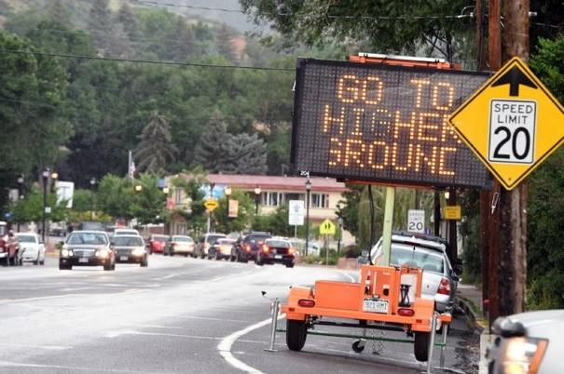
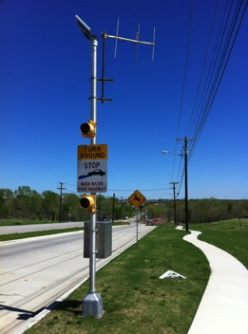
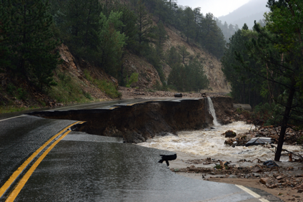
Real-time cameras inform all stakeholders & officials
Tailoring warnings to where people ARE & where they NEED them
New tools observe actual behavior – NOT what people say they would do
Helen H. Richardson/
The Denver Post
Notes:
When I began my career networked stream gages and raingages were state of the art. Mamy decision makers had to wait for phone calls to tell them how much rain had fallen upstream.. Now they are connected by instant internet access and complemented by many other observation tools – including real time cameras.. That
Warn motorists as its happening .. that the low point on the road they are about to cross is --- flooded – or that lots of mud is sliding down the burn scar, headed for towns below …

Slide 30
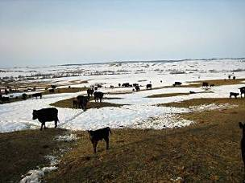

Tanja Fransen
Warning Coordination Meteorologist Glasgow,
Montana
Cold Advisory for Newborn Livestock (CANL) http://www.wrh.noaa.gov/ggw/canl/canl.html
Hundreds of millions of $ lost each year to livestock due to weather each year
Building her career with focus on impacts & service

Slide 31
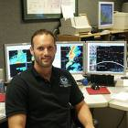
Daniel Nietfeld
Scientific Operations Officer
National Weather Service
Omaha, Nebraska USA
Teaching weather &
society class
Redefining job to include
social & physical sciences
Who will be impacted?
Are people awake/sleeping/
driving/coaching?
What has happened up to this point?
Have there already been fatalities?
What is social media/tv saying?
Since WAS*IS I look at everything the National Weather Service does from a decision-makers‘ viewpoint, or from the perspective of people who are impacted by our products, services & efforts
Brings stakeholders to meetings & attends THEIR meetings: school superintendents, highway patrol, hospital administrators & others
Notes:
November 27-29, 2001
Central Region Warning Improvement Workshop
31

Slide 32
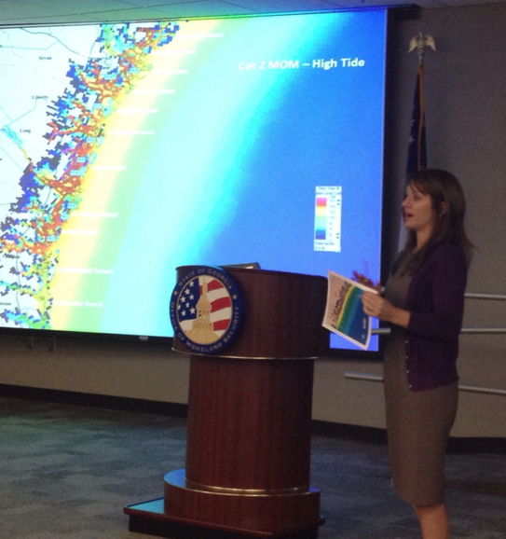
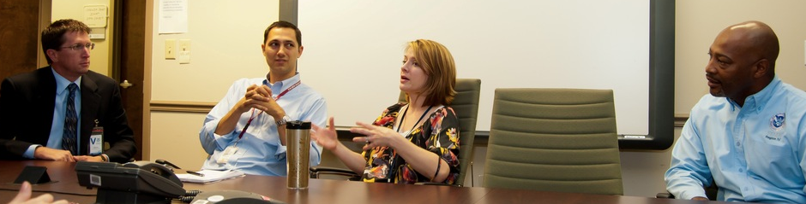
Rebecca Jennings
Communication undergrad degree she wanted to be a meteorologist
Through persistence – & a refusal to take NO as an answer Georgia Tech professor helps her select prerequisites – she completes MS in atmospheric science
Now: Federal Emergency Management Agency
Hurricane Specialist

Slide 33


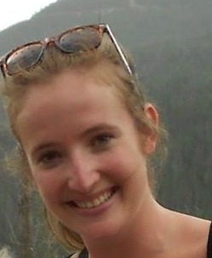
Where to study?
No one place
Ph.D. students
Jen Spinney U of Western Ontario Anthropology
Amber Silver Nelson U of Waterloo Geography
Stephanie Hoekstra East
Carolina University
Coastal resource management

Slide 34

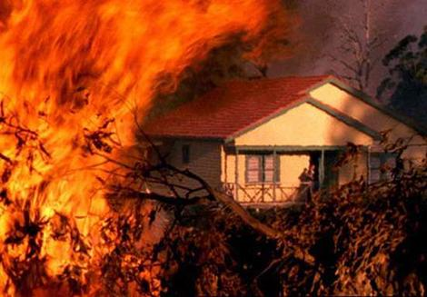
Research findings challenge assumptions – Read, Watch, Use them No need to re-invent Build on what we know
See: Robert Meyer “The faulty mental models that lead to poor disaster preparation” 07/07/2014
Beware of mental models, optimism bias & warning fatigue that limit ability or willingness to respond to warnings even if they are accurate
* Brenda Mackie 2014
dissertation on
bushfire warning fatigue

Slide 35


NOAA Science Advisory Board 2013: In the Nation's Best Interest: Making the Most of NOAA's Science Enterprise – Final Report from Research & Development Portfolio Review Task Force
From parallel universe
to woven fabric of physical
& social science
Calls for more & woven in social science keep coming – Adjacent social science is add-on

Slide 36

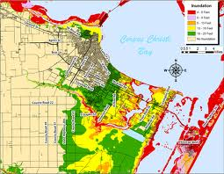
No it’s NOT getting people to do anything – Provide people with what they say they need
“….we’re talking about the intersection of nature & society, & at that intersection it’s not just physical science but the science of how to get people to listen, respond & act”

Slide 37
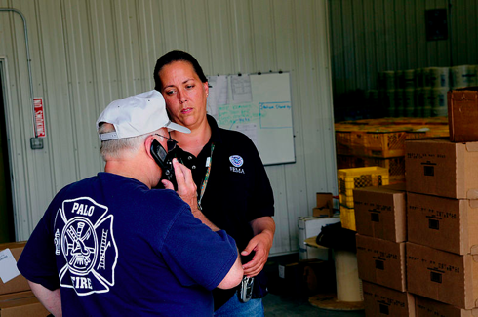
Bring forecasters & emergency managers to your lab
It’s not just about communicating better
We need more than more accurate information to save lives
Start with learning what they
already use
what their timeframes are
their definitions of severe are &
what their primary decision making concerns
are
Product development must occur with the inclusion of ALL user perspectives & needs
Don’t start with a product you are already heavily invested in

Slide 38
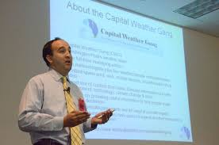
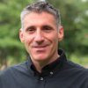
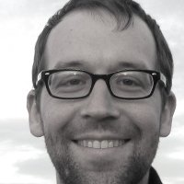
New media – interpretations beyond traditional channels: blogs & other social media
Jason Samenow capitalweathergang.com
Kenny Blumenfeld Weather & BS
http://www.kennyblumenfeld.com/
Interactive web broadcasts
Weatherbrains
http://weatherbrains.com/weatherbrains
Eric Holthaus
http://www.slate.com/authors.eric_holthaus.html

Slide 39
Change Research-to-Operations dynamic to be more inclusive - not top down
Developers
Private Sector & Media
Weather Forecasters
6
Publics
Researchers
Emergency Managers & 1st Responders
Publics

Slide 40
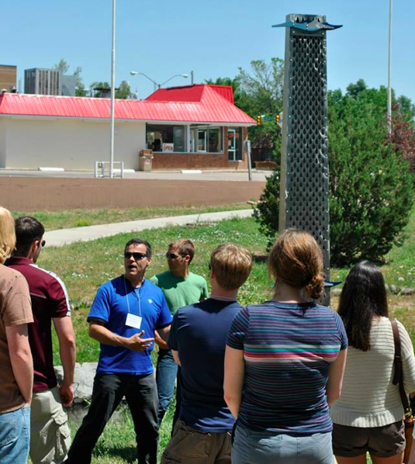
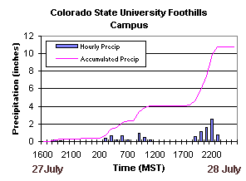
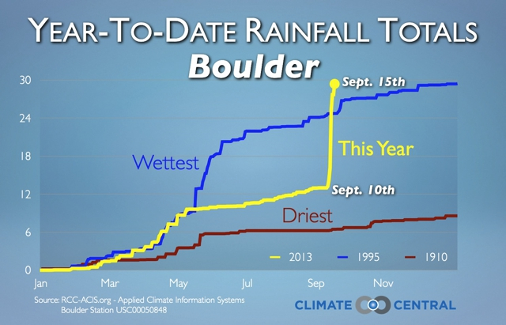
Agility is necessary with reduced relevance of past records
Fire/flood threats/seasonality

Slide 41


WAS * IS means changing from WAS to IS
WAS physical scientist
uses the words of social science
Becomes WAS social
scientist!
Moving from WAS to IS is not an instant transition - WAS*ISers realize the importance of CONNECTING WITH STAKEHOLDERS

Slide 42


In 1976 144 people died in the Big Thompson Flood in Colorado – 10 people died in the much bigger 2013 floods
People were not caught on roads as they washed out
Roads/businesses/schools were closed
Take credit for how many lives were saved
Develop new metrics
Denvercbslocal.com

Slide 43

Work is being done by dedicated brave charismatic policy entrepreneur scientists who weave social science into their daily work
EXHAUSTING & unsustainable without institutional support
Developing collaborations has to be considered as metric for promotion –not fluff or “outreach”
Repeat our message until people say it to us in their own words?

Slide 44
The committee recognizes that
- thorough assessments of the benefits of weather forecasting or of other weather services do not exist
- that dissemination of information to the public is largely based on traditional procedures using outmoded technology &
- that there is often insufficient interaction between the user & the information system
National Research Council Committee on Atmospheric Sciences The Atmospheric Sciences & Man’s Needs Priorities for the Future 1971
Notes:
New model

Slide 45

Challenges
Many still underestimate value of social science (dilutes physical science, not rigorous)
Cheerleading or talking to a social scientist is not doing social science
Need for collaborations
Little follow through – constantly re-inventing
Sobering funding environments
Social scientists not interested in being add ons
Placeholders Some of the brightest people have
vested interest in keeping things the same
Is it strategic to stand still as a hedge against
losing ground?
Placeholder

Slide 46


Positive change agents
Hybrid scientists
* Julie Demuth
Co founder of WAS* IS
MS in meteorology Ph.D. (soon) in Communication
Expertise in qualitative & quantitative methods
More seniority
* Rebecca Morss
Leading social science research group at National Center for Atmospheric Research
New large projects funded
Notes:
Peoplle are leading the way…

Slide 47


Summary Network, research & forecaster illustrations highlight directions & opportunities
Integrated work requires NEW
We need ways to speak across disciplines, scales, agencies & sectors
Momentum is building
research questions
research methods
research collaborations

Slide 48
When WAS * IS movement began in 2005
Meteorologists commented on weather – wind speed, hail size (not on impacts)
Agencies/disciplines adjacent but not integrated
Social science considered weird & exotic
Now in 2014
Complex discussions
Diversity of discussants
Emergency managers, forecasters, broadcast meteorologists, grad students, private sector
Decision support
Timelines – planning to response
Research results – application of range of stakeholder spatial & temporal needs
Social scientists’ growing role in post-disaster surveys

Slide 49

Thanks to Brian Mills & his team for hard work to get the User, Application & Social Science (UAS) Program organized at World Weather Open Science Conference 2014
Ten years from now: In 2024 Integrated Sessions –
Ways of doing integrated weather science that are no longer “new”
Looking forward to discussions &
other sessions

Slide 50
References
Collaborative Adaptive Sensing of the Atmosphere http://www.casa.umass.edu/
Committee on Atmospheric Sciences National Research Council (1971) The Atmospheric Sciences & Man’s Needs Priorities for the Future National Academy of Sciences
Gruntfest, E (1977) What people did during the Big Thompson Flood http://www.colorado.edu/hazards/publications/wp/wp32.pdf
League, CE et al (2012) Tornado warning communication & emergency manager decision-making, presentation at American Meteorological Society 24 January http://ams.confex.com/ams/92Annual/flvgateway.cgi/id/20175?recordingid=2017
Meyer, R (video) The faulty mental models that lead to poor disaster preparation 07/07/2014 http://knowledge.wharton.upenn.ed/article/wind-rain-worse/
NOAA SAB (2013) In the nation’s best interest: Making the most of NOAA’s science enterprise
Spinney, J & E Gruntfest (2012) What makes our partners tick? Using ethnography to inform the Global System Division’s development of the Integrated Hazards Information Services (IHIS) Report prepared for NOAA Integrated Hazards Information Systems Project http://www.evegruntfest.com/SSWIM/pdfs/Final-rep-1.pdf
Wilhelmi, O and M Hayden 2010 Connecting people and place: a new framework for reducing urban vulnerability to extreme heat Environmental Research Letters 5 1-8doi:10.1088/1748-9326/5/1/014021

